Slide 1
Stock Sentiment Analysis Report
By Ronak Uchariya at Praedico Global Research Pvt. Ltd. July 31, 2021

Slide 2
Data set
Description:
1 Historical news headlines crawled from Reddit WorldNews Channel (/r/worldnews). They are ranked by reddit users' votes, and only the top 25 headlines are considered for a single date (Range: 2008-06-08 to 2016-07-01)
Stock data: Dow Jones Industrial Average (DJIA) is used to "prove the concept". (Range: 2008-08-08 to 2016-07-01)
There are only two labels:
"1" when DJIA Close value rose or stayed as the same;
"0" when DJIA Close value decreased.
Daily News for Stock Market Prediction, Version 1. Retrieved [Date You Retrieved This
Data] from https://www.kaggle.com/aaron7sun/stocknews.

Slide 3

Methodology
Natural language processing (NLP) is considered to be a powerful tool for understanding and interpreting human languages like speech and text. Natural language processing is useful in text analysis and text mining. Frequently, used two techniques for natural language processing are;
1) Bag of words
2) TF-IDF (Term Frequency — Inverse Data Frequency)

Slide 4
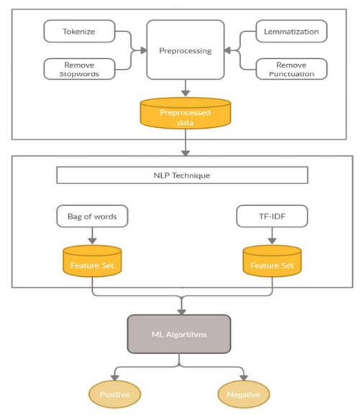
Model framework
Raw Data

Slide 5
Classification accuracy for five algorithms
Sr. No. | Algorithm | Technique | Classification Accuracy (%)
1 | Random Forest | Bag-of-words TF-IDF | 84 84
2 | K- Neighbors Classifier | Bag-of-words TF-IDF | 57 57
3 | Support vector machine | Bag-of-words TF-IDF | 83 85
4 | Logistic Regression | Bag-of-words TF-IDF | 84 81
5 | Decision Tree Classifier | Bag-of-words TF-IDF | 85 85

Slide 6
Accuracy sector chart

Slide 7
Summary
Google Collaboratory notebook link
Note book link - https://colab.research.google.com/drive=sharing
Data set link
Data - Daily News for Stock Market Prediction | Kaggle

